Slide 1
Kubernetes in Action
AH SHAH KHAN

Slide 2
Agenda
Monolithic Architecture
Microservices
Complexities of Microservices
What is Kubernetes?
The Origin of Kubernetes
A Broader Perspective
The Purpose of K8s
Kubernetes Architecture
Kubernetes Master
Worker Nodes
Hitting a Moving Target
Benefits of K8s
Required Tools

Slide 3
Monolithic Architecture

Slide 4
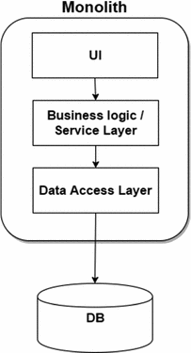
Monolithic Architecture
Designed to be self-contained
Has all that is needed in itself

Slide 5
Issues with Monolithic Architecture
Slow release cycles and relatively infrequent updates
Once new release gets ready, developers package up the whole system and hand it over to the ops team, who then deploys and monitors it
In case of hardware failures, the ops team manually migrates it to the remaining healthy servers

Slide 6
Microservice Architecture

Slide 7
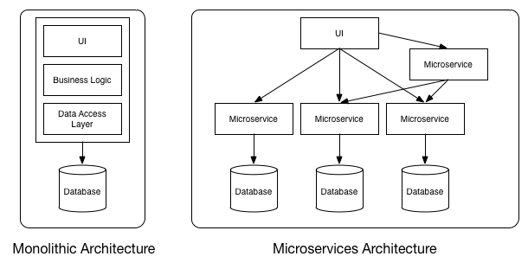
Microservice Architecture
Breaking down big applications into smaller components
Microservices are decoupled from each other

Slide 8
Microservice Architecture
They can be developed, deployed, updated, and scaled individually

Slide 9
Microservice Architecture
Making a change to any component is convenient and new technology can be adopt where needed

Slide 10
Complexities of
Microservice Architecture

Slide 11
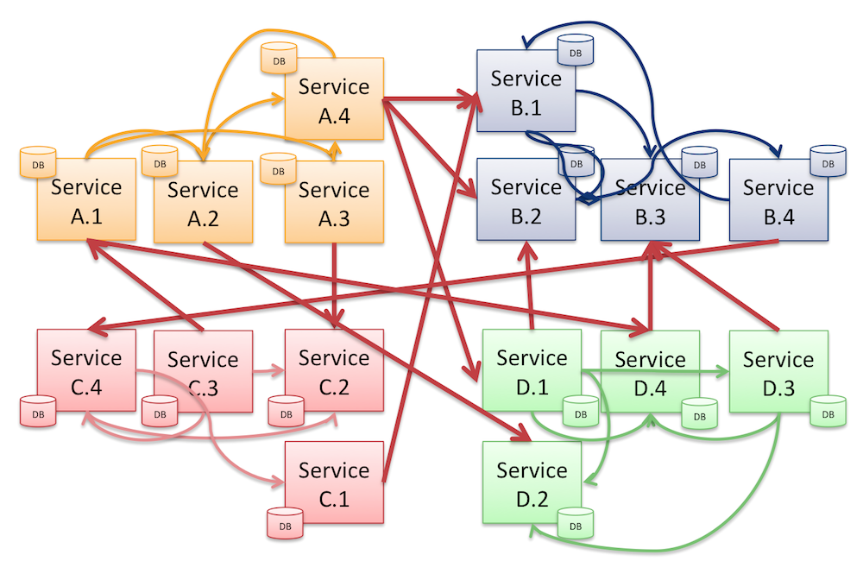
Complexities of
Microservice Architecture
Configuring, managing, and keeping the whole system running smoothly
Achieving max hardware resource utilization
Making sure all services are working
Scaling services

Slide 12
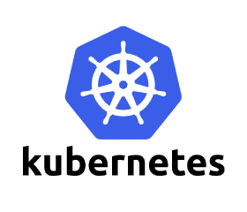
Automated:
Scheduling
Configuration
Supervision
Failure-handling

Slide 13
What is Kubernetes?

Slide 14
What is Kubernetes?
Developers can deploy applications as often as they want, without assistance from the operations team
It also helps the ops team by automatically monitoring and rescheduling apps in the event of hardware failure
Exposes your whole data center as a single enormous computational resource

Slide 15
What is Kubernetes?
When you have multiple servers and you are deploying a multi-component application through Kubernetes,
Selects a server for each component
Deploys components
Enables accessibility and communication easy among all application components

Slide 16
Magical Powers of Kubernetes
Easy component management makes Kubernetes great for most on-premises data centers & cloud providers
Kubernetes allows cloud providers to offer developers a simple platform for deploying and running any type of application, while not requiring the cloud provider’s own sysadmins to know anything about the tens of thousands of apps running on their hardware.

Slide 17
The Origin of Kubernetes

Slide 18
The Origin of Kubernetes
Google created a system for there internal use with the name “Borg”
Later they changed the name of Borg with “Omega”
The Purpose of Borg/Omega was to help both application developers and system administrators manage google’s applications and services

Slide 19
The Origin of Kubernetes
Helped them achieve a much higher utilization of their infrastructure, which is important when your organization is that large.
A decade after the creation of Borg/Omega, Google introduced Kubernetes in 2014, an open-source system based on the experience gained through Borg, Omega, and other internal Google systems.

Slide 20
A Broader Perspective of Kubernetes

Slide 21
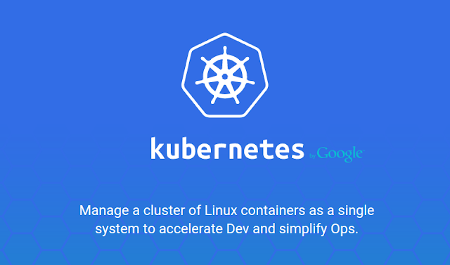

Slide 22
A Broader Perspective of Kubernetes
Kubernetes enables you to run your software applications on thousands of computer nodes as if all those nodes were a single computer
It abstracts away the underlying infrastructure and, by doing so, simplifies development, deployment, and management

Slide 23
A Broader Perspective of Kubernetes
Deploying applications through Kubernetes is always the same, whether your cluster contains only a couple of nodes or thousands of them
The size of the cluster makes no difference at all

Slide 24
The Purpose of Kubernetes

Slide 25
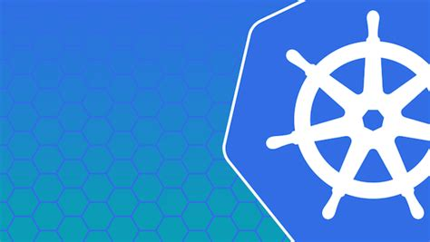
An OS for
the Cluster

Slide 26
The Purpose of Kubernetes
Application developers can focus on their application instead of infrastructure-related services into their apps:
Service discovery
Maximize resource utilization
Scaling / Load-balancing
Self-healing

Slide 27
Service Discovery
Kubernetes will:
run your containerized app somewhere in the cluster
provide information to its components on how to find each other
keep components running

Slide 28
Maximize Resource Utilization
Kubernetes can relocate the app at any time
By mixing and matching apps, Kubernetes can achieve far better resource utilization than is possible with manual scheduling

Slide 29
Scaling / Load Balancing
Easily add or remove app replica manually and kubernetes then will auto divert traffic to each for load balancing
Kubernetes will add or remove copies (replicas) of your application based on real-time metrics, such as CPU load, memory consumption, queries per second, or any other metric your app exposes

Slide 30
Self Healing
Kubernetes checks our application’s health on a described period and it also does the needful in case there is no response from the containerized app
In case of worker node failure Kubernetes immediately starts up another worker node

Slide 31
Kubernetes Architecture

Slide 32
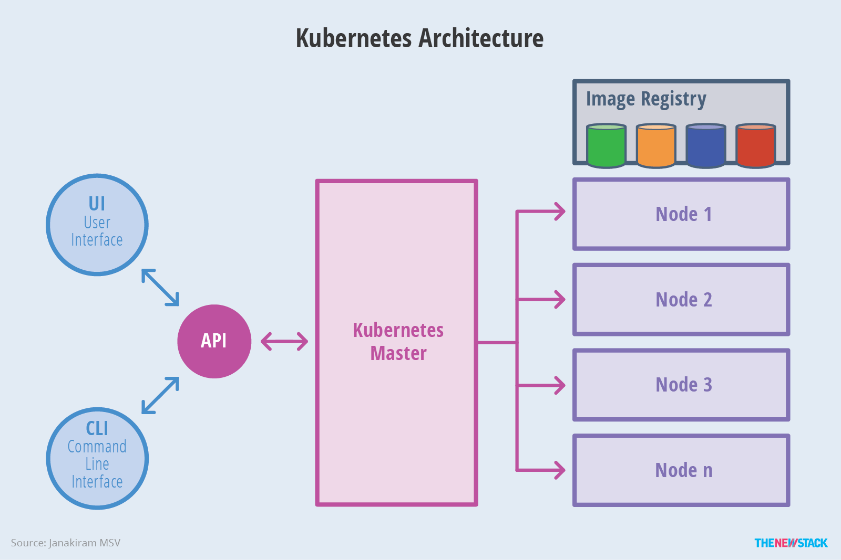

Slide 33
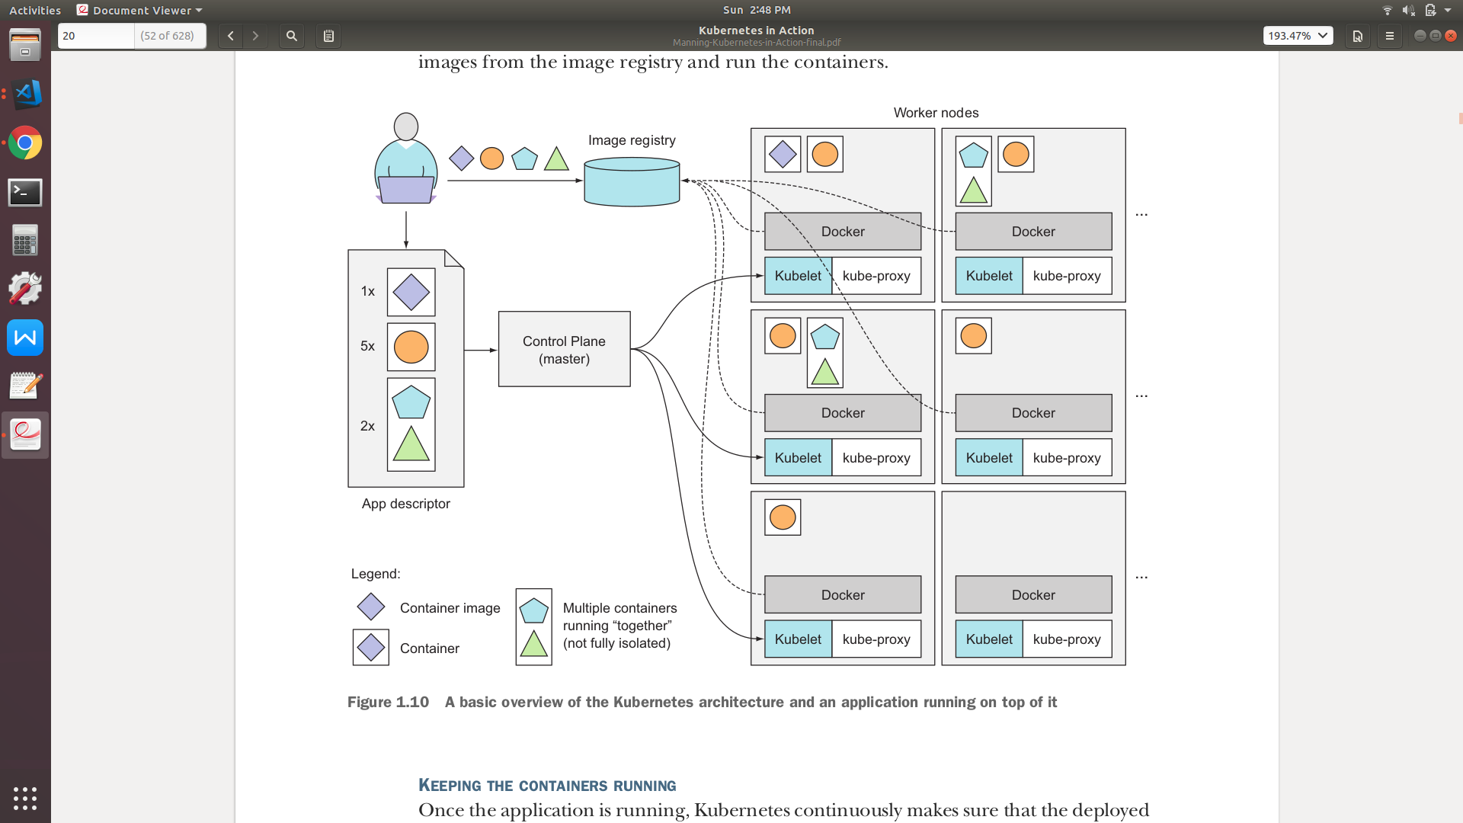

Slide 34
Kubernetes Master

Slide 35
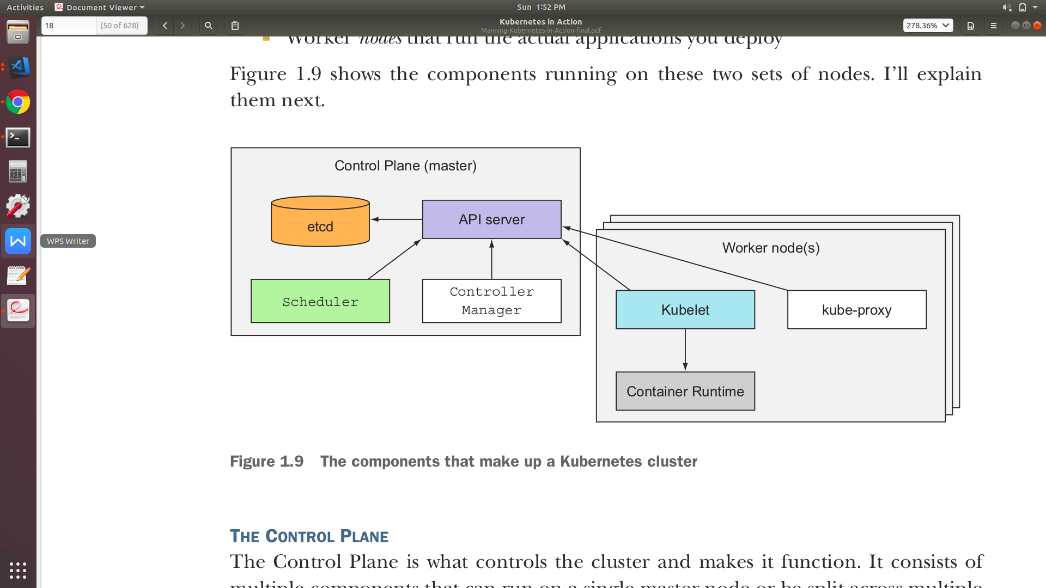
Kubernetes Master - The Control Plane (Master)
The control plane (master) is what controls the cluster and makes it function.
The control plane consists of multiple components.
It could be on a single master node or be split across multiple nodes and replicated to ensure high availability.

Slide 36
Kubernetes Master - etcd
a reliable distributed data store that persistently stores key-value data of the cluster configuration

Slide 37
Kubernetes Master - Scheduler
The Scheduler, which schedules your apps i.e. assigns a worker node to each deployable component of your application depending on resource requirement by app and resource availability of the node.

Slide 38
Kubernetes Master - Controller Manager
The Controller Manager, which performs cluster-level functions, such as replicating components, keeping track of worker nodes, handling node failures, and so on

Slide 39
Kubernetes Master - API Server
The Kubernetes API Server, which you (user), other Control Plane and worker node components communicate with

Slide 40
Kubernetes Worker Nodes

Slide 41
Kubernetes Master - Worker Nodes
The worker nodes are the machines that run your containerized applications.

Slide 42
Kubernetes Master - kube-proxy
A networking proxy that runs on each worker node, enables pod to pod, pod-to-service communication
The Kubernetes Service Proxy (kube-proxy), which also load-balances network traffic between application components.

Slide 43
Kubernetes Master - Container Runtime
Docker, rkt, or another container runtime, which runs your containers

Slide 44
Kubernetes Master - Container Runtime
Manages and takes responsibility for containers on its node. It ensures that the containers described in those PodSpecs are running and healthy

Slide 45
Hitting a Moving Target

Slide 46
Hitting a Moving Target
Kubernetes may need to move containers around the cluster
This can occur in any of the follow case
The node they were running on has failed
Because they were evicted from a node to make room for other containers

Slide 47
Hitting a Moving Target
If the container is providing a service to external clients or other containers running in the cluster,
how can they use the container properly if it’s constantly moving around the cluster?
how can clients connect to containers providing a service when those containers are replicated and spread across the whole cluster?

Slide 48
Hitting a Moving Target
Kubernetes keeps track of all the containers it manages
If multiple containers provide the same service then you can group them at a single static IP address
Kubernetes then expose that address to all applications running in the cluster or to the outside world

Slide 49
Hitting a Moving Target
The kube-proxy will make sure connections to the service are load balanced across all the containers that provide that same service
The IP address of the service stays constant, so clients can always connect to its containers, even when they’re moved around the cluster

Slide 50
Benefits of Kubernetes

Slide 51
Benefits of Kubernetes
The ops team doesn’t need to deal with deploying your apps anymore because a containerized application already contains all it needs to run, the system administrators don’t need to install anything to deploy and run the app.
On a node where Kubernetes is deployed, K8s can run the app immediately without help from sysadmins

Slide 52
Tools Required for Running Kubernetes

Slide 53
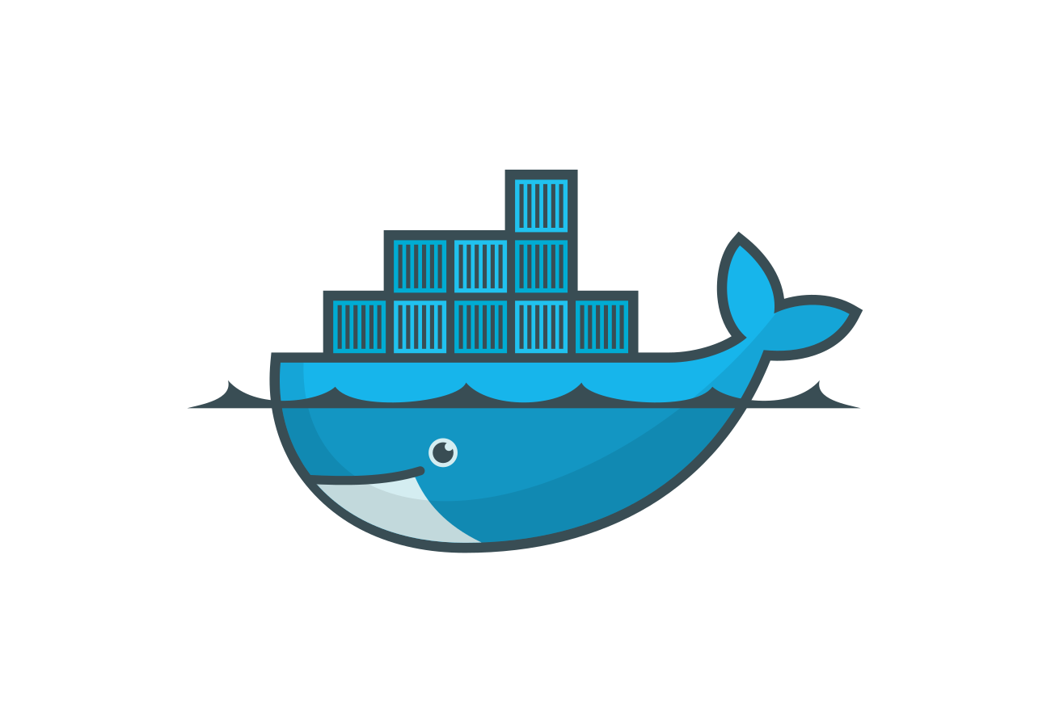
Docker - http://docs.docker.com/engine/installation/

Slide 54
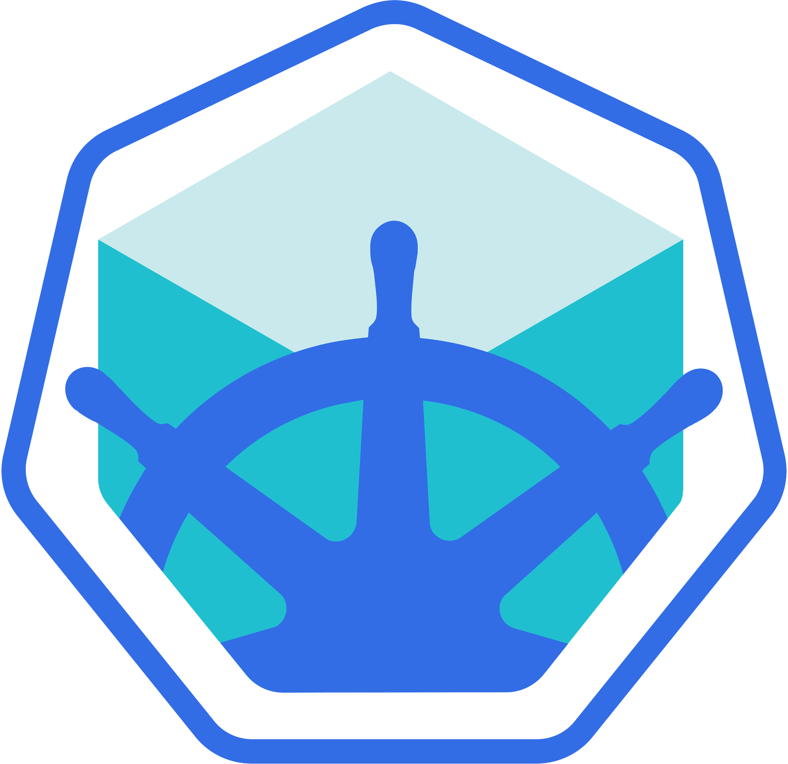
Minikube - http://github.com/kubernetes/minikube

Slide 55
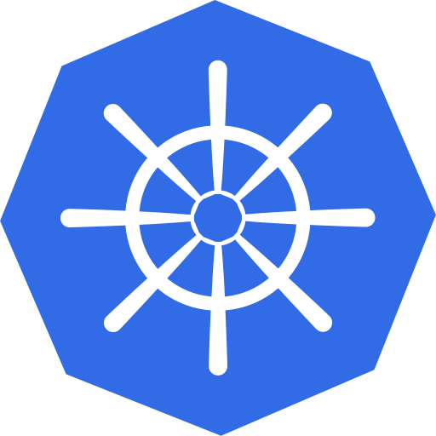
Kubernetes Client (KUBECTL) - https://kubernetes.io/docs/tasks/tools/install-kubectl/

Slide 56
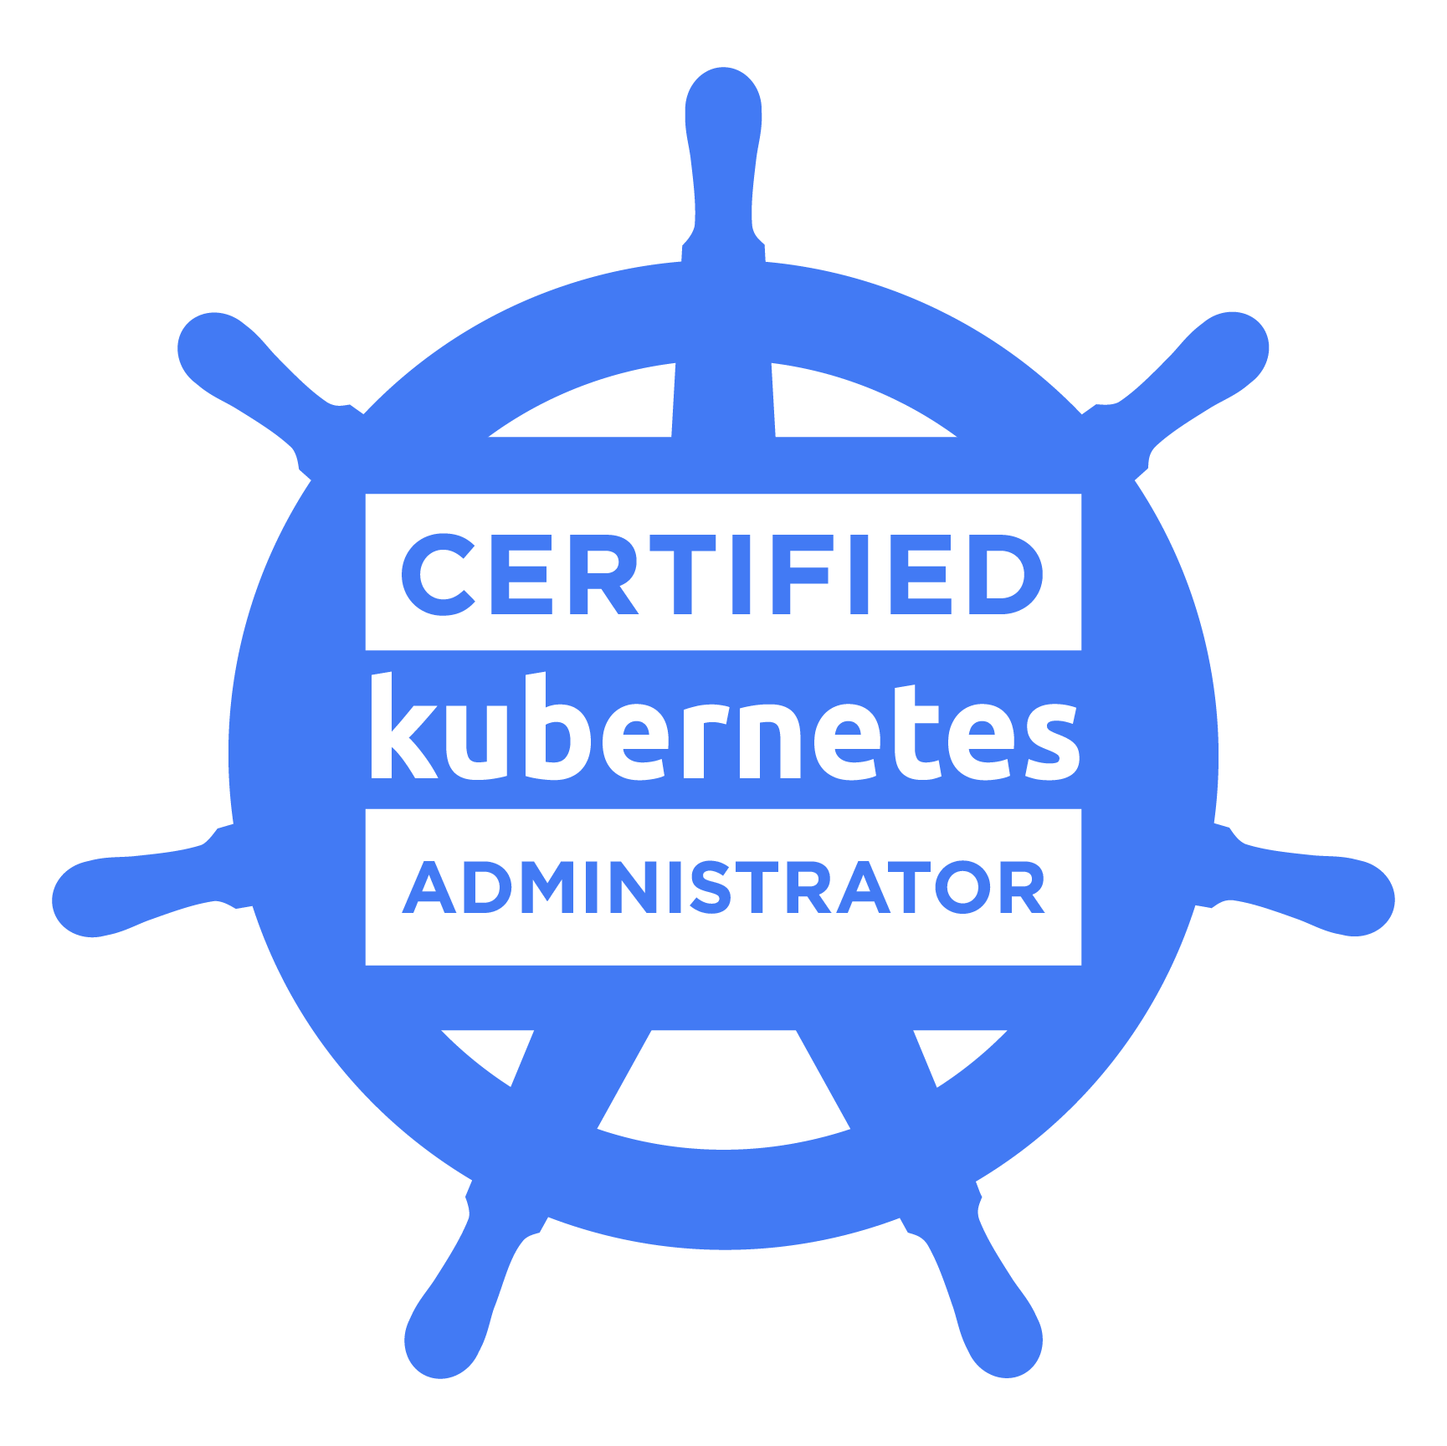
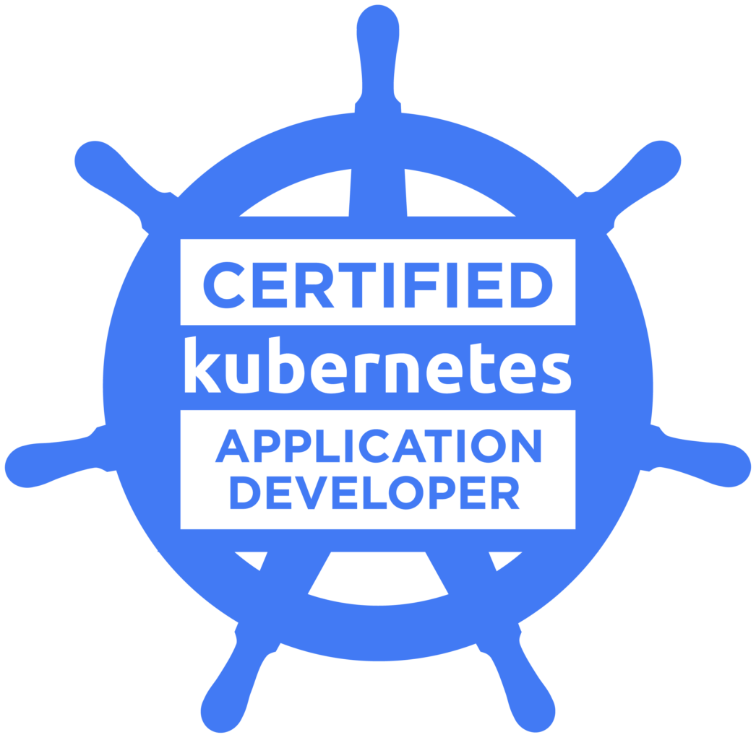

Slide 57
13% – Core Concepts
18% – Configuration
10% – Multi-Container Pods
18% – Observability
20% – Pod Design
13% – Services & Networking
8% – State Persistence
Certified Kubernetes Application Developer (CKAD)

Slide 58
Minikube
Minikube - http://github.com/kubernetes/minikube

Slide 59
Minikube
The Kubernetes architecture consists of the master and worker nodes
Minikube is a tool that makes it easy to run Kubernetes locally
Minikube runs a single-node Kubernetes cluster on your laptop to use kubernetes for practice or development

Slide 60
minikube start
To start your local Kubernetes cluster using minikube

Slide 61
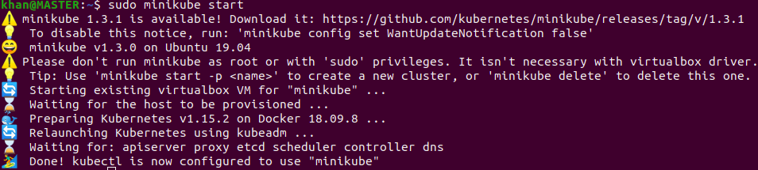
Run the command
Minikube start or Sudo minikube start
Wait until it is done, configured and ready to use

Slide 62
minikube status
To find the current state of minikube

Slide 63
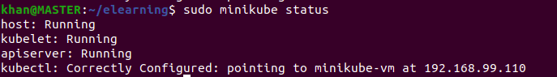
Run the command
Minikube status or Sudo minikube status

Slide 64
kubectl cluster-info
To find the state of the kubernetes cluster in minikube

Slide 65
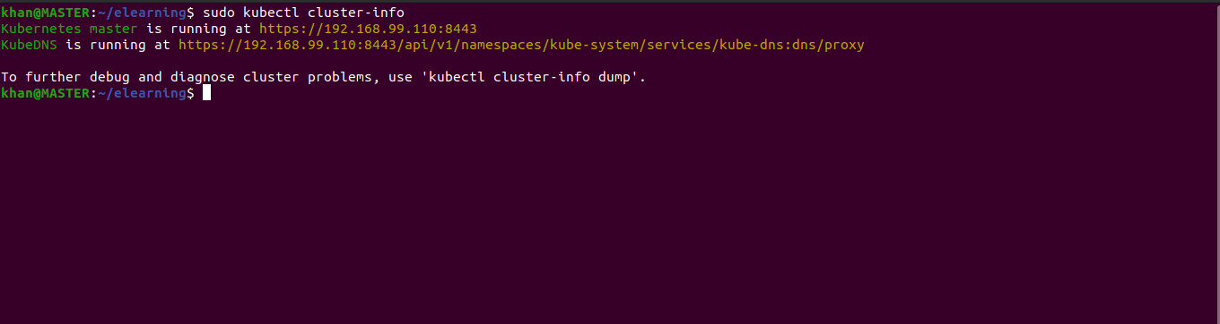
Run the command
sudo kubectl cluster-info or kubectl cluster-info

Slide 66
Nodes

Slide 67
Nodes
A group of servers is called a cluster
A K8s cluster consists of master and worker nodes
The master node acts as a manager
Worker nodes are servers or systems on which K8s deploys and runs applications

Slide 68
kubectl get nodes
To list nodes in a kubernetes cluster

Slide 69
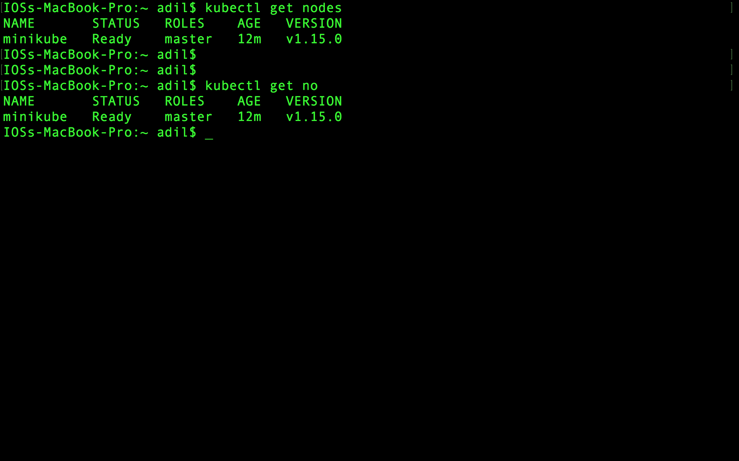

Slide 70
kubectl describe node <name>
To get a description of a kubernetes node

Slide 71
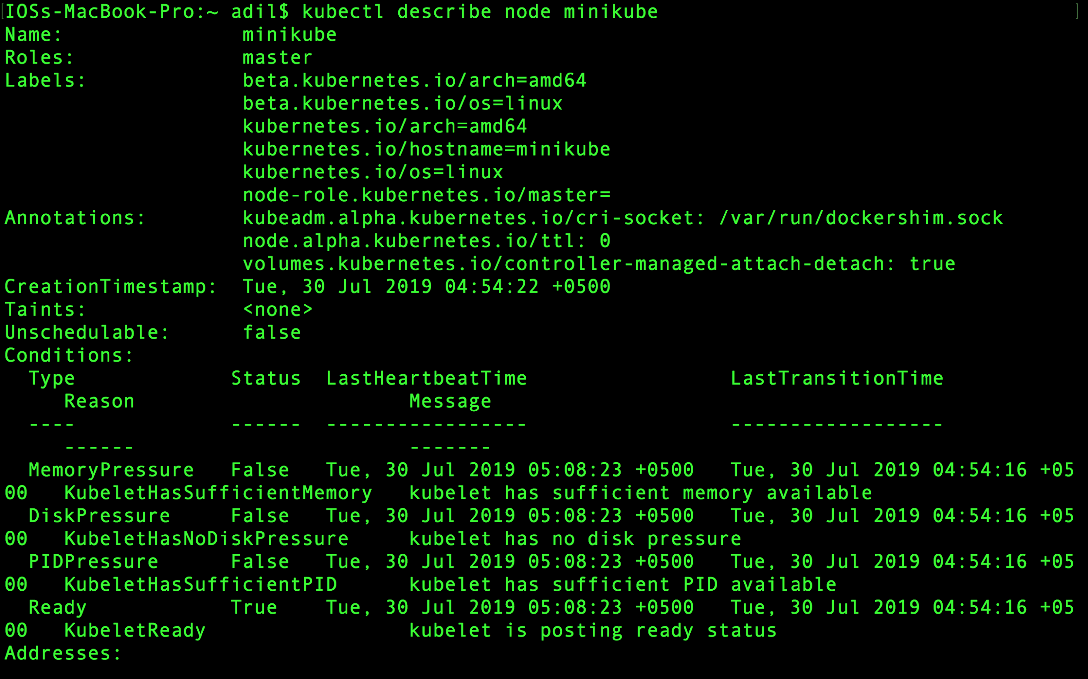

Slide 72
Alias

Slide 73
Alias
The linux alias command enables us to shorten lengthy and frequently used commands with an alias.

Slide 74
alias <alias>=<command>
To use an alias to shorten lengthy and frequently used kubectl commands

Slide 75
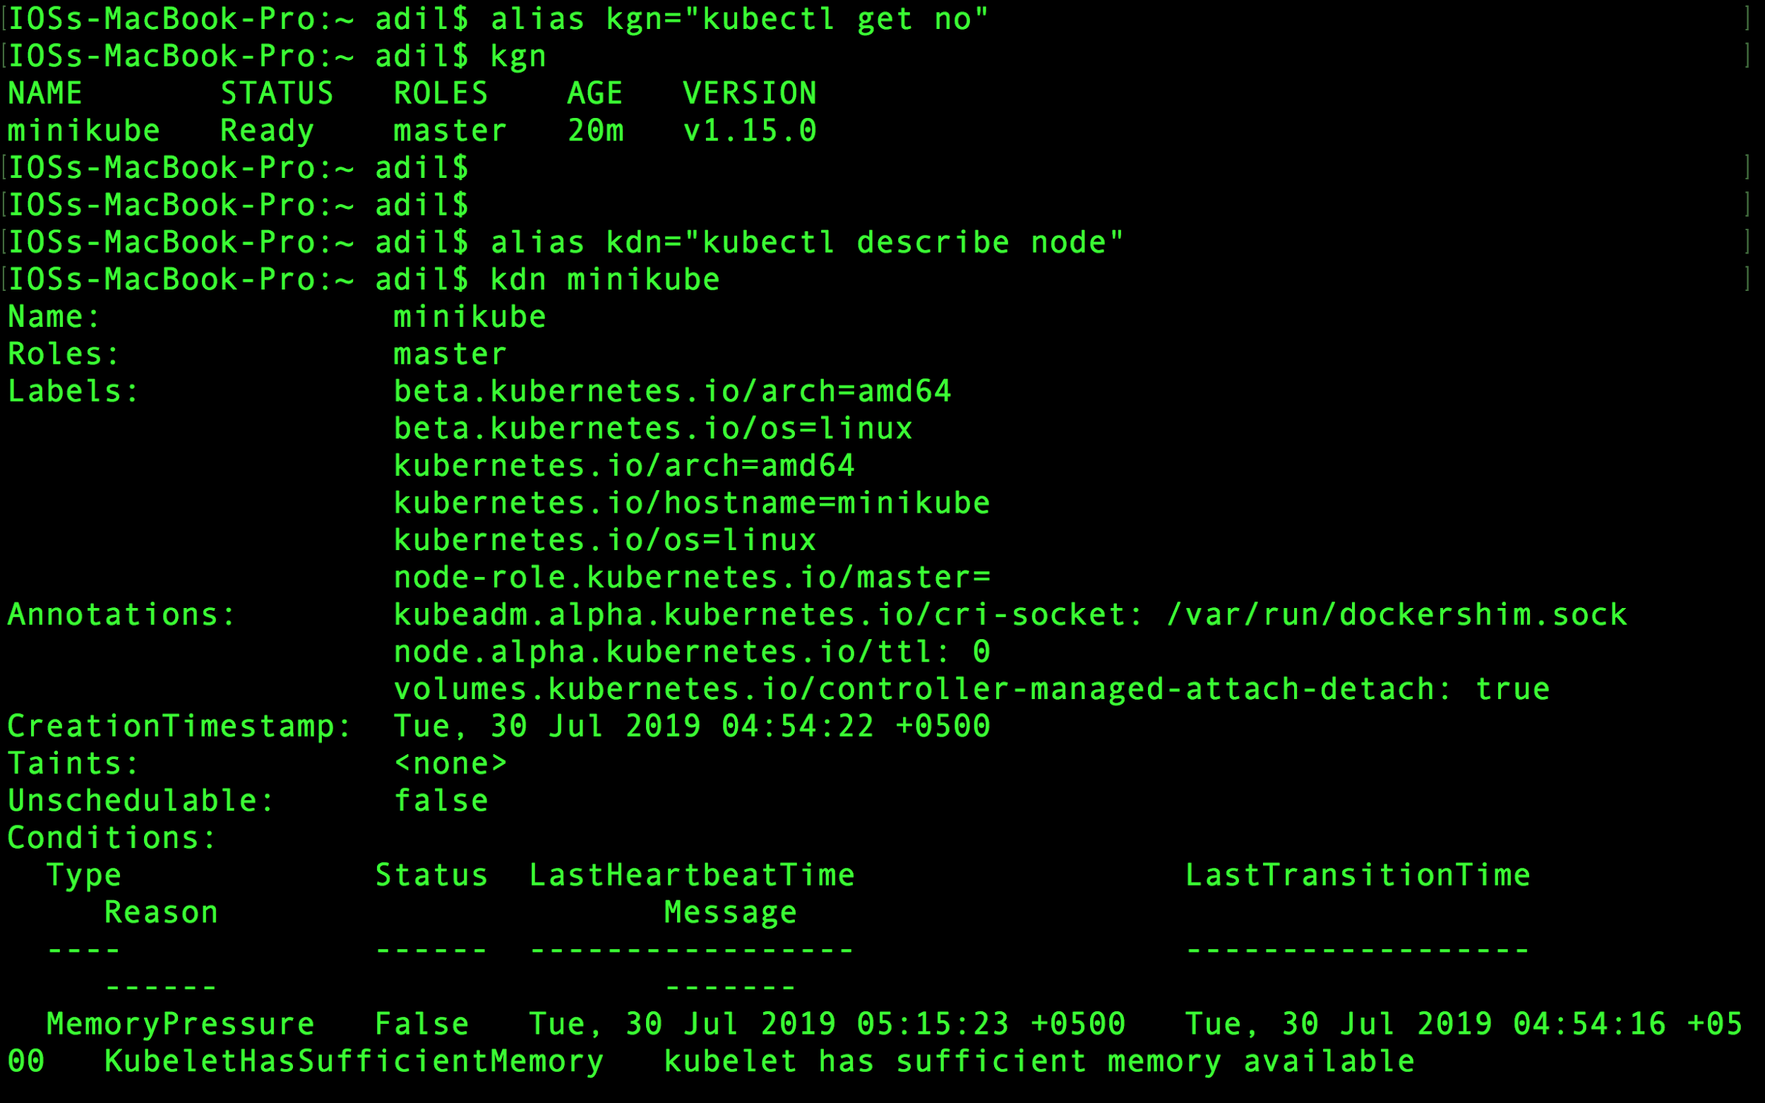

Slide 76
Pods

Slide 77
Pods
To run an application on K8s, the most basic condition is the application must be containerized
K8s does not deploy the application’s container directly like Docker
K8s wraps the application container or group of containers together into a Pod

Slide 78
Pods
Each pod is like a separate logical machine with its own IP, hostname, processes, and so on, running a single application.

Slide 79
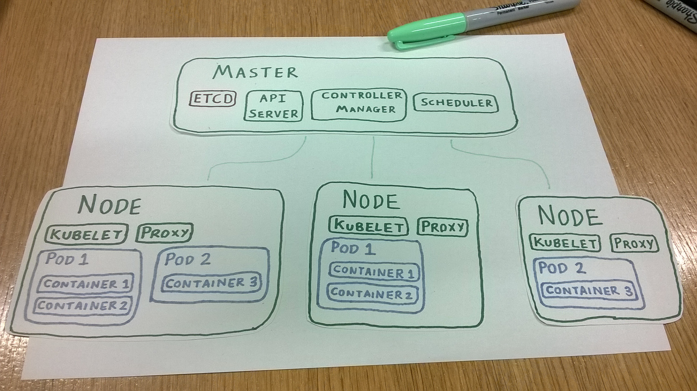

Slide 80
Pods
All the containers in a pod will appear to be running on the same logical machine.
A Pod with multiple containers will always run on the same worker node.

Slide 81
Why Pods?

